Slide 2

Shigeo Shingo: Lean Manufacturing Visionary
Shigeo Shingo was a Japanese industrial engineer who revolutionized manufacturing with his innovative methods.

Slide 3

Shingo's Contribution to Lean Manufacturing
1
Eliminating Waste
2
Improving Quality
3
Increasing Efficiency
Shingo focused on identifying and eliminating waste in all forms.
He emphasized building quality into the process rather than inspecting for defects.
He developed techniques to optimize production and reduce cycle times.

Slide 4

The Concept of Poka-Yoke (Mistake-Proofing)
Mistake-Proofing
Built-In Safeguards
A method of designing processes and equipment to prevent errors from happening.
Poka-yoke uses simple mechanisms to detect and prevent errors.

Slide 5




Poka-Yoke: Preventing Defects at the Source
Color Coding
Shape Matching
Using different colors to identify parts or steps in a process.
Designing parts with unique shapes that can only fit together correctly.
Sensors and Alarms
Using sensors to detect errors and trigger alarms.

Slide 6

Single-Minute Exchange of Dies (SMED)
1
Internal Setup
Tasks that can be performed while the machine is still running.
2
External Setup
Tasks that require the machine to be stopped.
3
Changeover Time
The time it takes to switch between producing different products.

Slide 7




SMED: Reducing Changeover Time
Standardize
Simplify
Streamline
Develop a clear and consistent procedure for changeovers.
Eliminate unnecessary steps and streamline the process.
Make it easier to perform tasks by using tools and equipment.

Slide 8



Implementing Poka-Yoke and SMED
Identify Problems
1
Analyze processes to identify areas for improvement.
Develop Solutions
2
Brainstorm and implement solutions to prevent errors.
Train and Implement
3
Train workers on the new processes and monitor results.

Slide 9
The Impact of Shingo's Principles on Lean
Reduced Waste
1
Minimizing defects and downtime leads to lower costs.
Improved Quality
2
Building quality in from the start reduces the need for inspections.
Increased Efficiency
3
Shorter cycle times and higher output lead to higher profits.

Slide 10
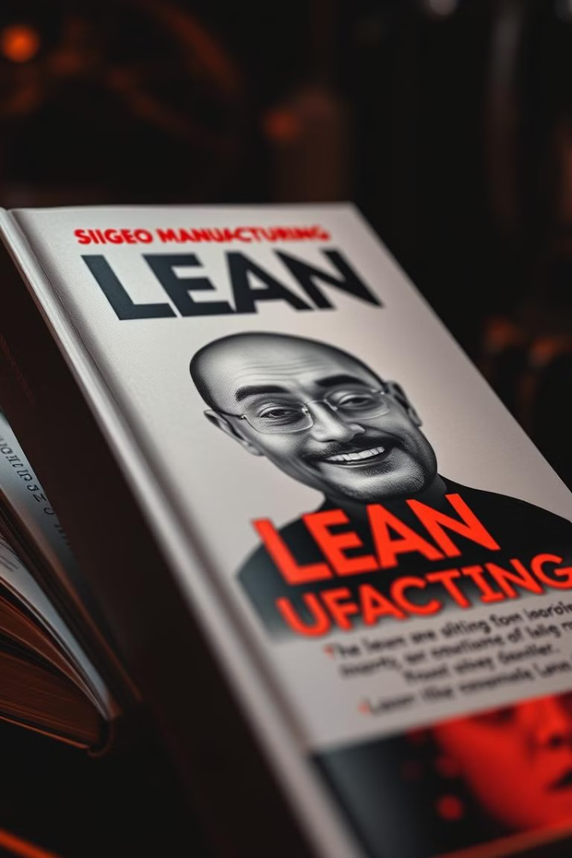
Shigeo Shingo's Legacy and Lessons Learned
Shingo's principles remain vital to modern manufacturing. By embracing his insights, businesses can achieve greater efficiency, quality, and customer satisfaction.

